Slide 1




COLUMBIA ASIA HOSPITALS ANALYSIS
N. SAI DHANUSH
APRIL 1, 2024

Slide 2
Problem Statement
You have been hired as a consultant data analyst by Columbia Asia Hospital.
Objectives:
- Assess the hospital's revenue generation
- Provide insights about suitable departments for new hires
- Suggest strategies for patient discounts
Task: Perform data analysis and report to help the organization with the mentioned objectives.

Slide 3
Introduction to Data
Date: Contains date and time information without specifying AM or PM (format: DD-MM-YYYY HH:MM).
Patient ID: Unique identifier for each patient (format: 124-62-3289).
Patient Gender: Records the gender of the patient ('M' for male, 'F' for female).
Patient Age: Age of the patients listed in years.
Patient Sat Score: Represents a satisfaction score given by or for the patient (single-digit score).
Patient First Initial: Contains the first initial of the patient's first name.
Patient Last Name: The surname of the patient is listed in this column. etc

Slide 4
Q. In analyzing the hospital dataset with Power BI, ensure data cleaning to address inconsistencies and missing values before further analysis.
Missing data values and data inconsistencies are handled to ensure and extract actionable insights from raw data.

Slide 5
Data Cleaning and Transformation
Key Steps:
- Handled missing values and data inconsistencies.
- Converted date columns to the correct format.
- Segregated patient ages into groups using DAX.
Tools Used: Power Query for data cleaning and transformation.

Slide 6
Data Modeling
Modeling Approach:
- Created relationships between tables for seamless data analysis.
- Used schema to ensure data integrity and accuracy.
Schema and Relationships: Include a simplified diagram of your data model.

Slide 7
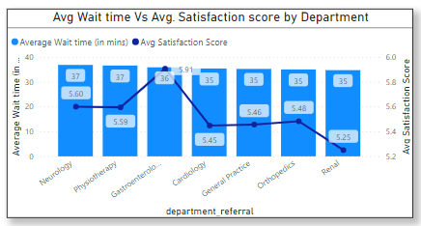
Insights and Analysis - Patient Wait Times
Analysis: Average wait time is 35.26 minutes.
Visual: Include a bar or line chart showing average wait times.

Slide 8

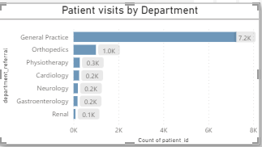

Insights and Analysis - Department Visits
Analysis: General Practice has the highest number of visits (78%).
Visual: Bar chart showing the count of visits per department.

Slide 9

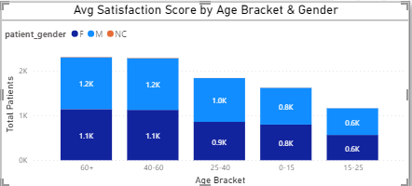

Insights and Analysis - Age Group Segmentation
Analysis: Segregated patients into 5 age groups to analyze healthcare utilization.
Visual: Column chart showing visits by age group.

Slide 10
Q. Were there any data format issues in the data, and if there were/are how you handle them?
Yes, there were data format issue. In Hospital ER data, where the date column was not in date format. Instead, it was in text format. So, this format doesn’t help us in making a slicer for date.
Thus, the format is changed to “Date” from text with the help of column functions in the Power Query Editor

Slide 11
Q. When we add a column in Power Query what’s the code that comes in M language in the formula bar? What do you know about M-query?
In Power Query, creating a new column results in M language code displayed in the formula bar, commonly formatted as `= Table.AddColumn(#"PreviousStepName", "NewColumnName", each [Expression])`. M-query, or Power Query Formula Language, empowers users to efficiently execute data transformation tasks within Power Query, aiding in activities such as data cleaning, reshaping, and preparation for loading into Excel or Power BI.

Slide 12
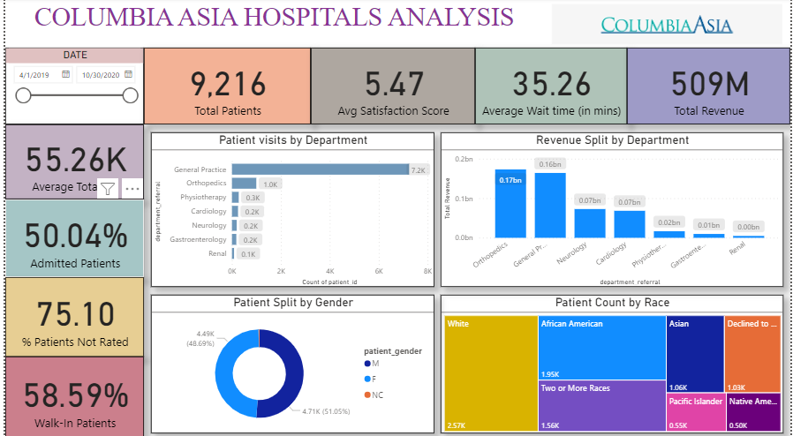
Dashboard (Main Tab)

Slide 13
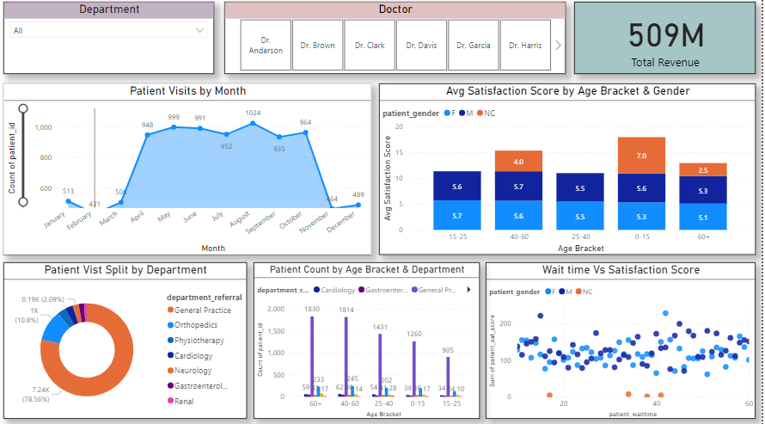
Dashboard(Doctor’s Tab)

Slide 14
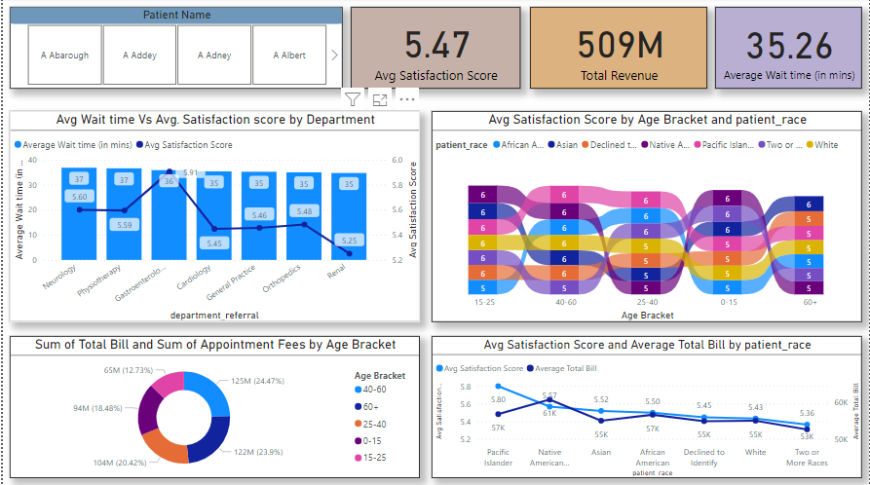
Dashboard(Patient’s Tab)

Slide 16
Thank You..✨

